Slide 1

Chapter 5
Advanced Encryption Standard (AES)

Slide 2
Outlines
Introduction to Advanced Encryption Standard (AES).
Design of AES.
Comparison of AES with DES.
Security of AES.

Slide 3
Learning Objectives
In the end of this Chapter 5, students will be able:
To understand the birth of Advanced Encryption Standard (AES).
To understand the design of AES, followed by its operations.
To understand and differentiate the difference between AES with DES.
To understand some security aspects of AES.

Slide 4
ADVANCED ENCRYPTION STANDARD (AES) HISTORY

Slide 5
Advanced Encryption Standard (AES) – History
A symmetric-key block cipher, AES was published by the National Institute of Standards and Technology (NIST) in December 2001.
It was designed by Belgium academics J. Daemen and V. Rijmen, hence AES is also known as Rijndael algorithm.
The selection of AES falls into the three criteria:
Security: Minimum key size to resist cryptanalysis.
Cost: Computational efficiency and storage requirement for various implementation.
Implementation: Flexibility and simplicity in various platforms.

Slide 6
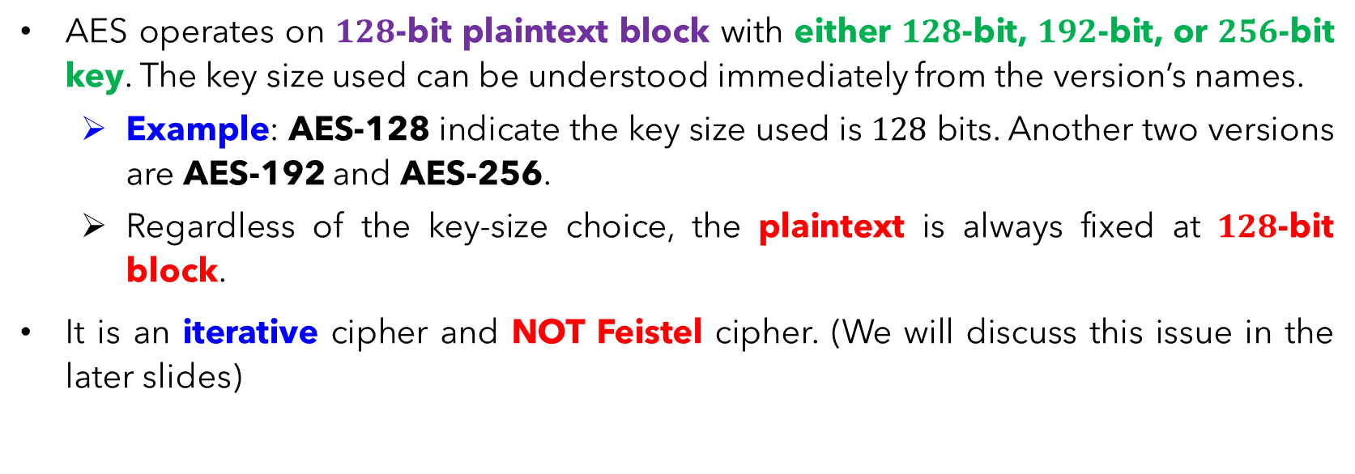
Advanced Encryption Standard (AES) – History
AES operates on $128$-bit plaintext block with either $128$-bit, $192$-bit, or $256$-bit key. The key size used can be understood immediately from the version’s names.
Example: AES-128 indicate the key size used is $128$ bits. Another two versions are AES-192 and AES-256.
Regardless of the key-size choice, the plaintext is always fixed at $128$-bit block.
It is an iterative cipher and NOT Feistel cipher. (We will discuss this issue in the later slides)

Slide 7
ADVANCED ENCRYPTION STANDARD (AES) DESIGN

Slide 8
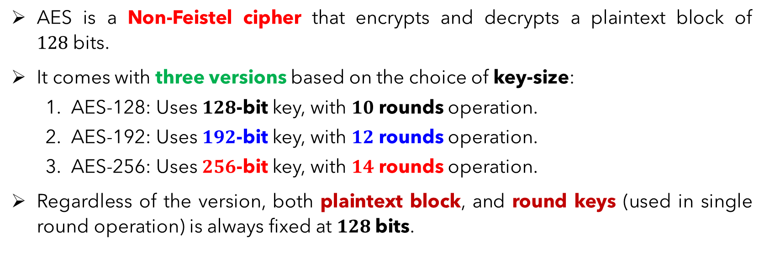
AES – Overview Design
AES is a Non-Feistel cipher that encrypts and decrypts a plaintext block of $128$bits.
It comes with three versions based on the choice of key-size:
AES-128: Uses $128$-bit key, with $10$ rounds operation.
AES-192: Uses $192$-bit key, with $12$ rounds operation.
AES-256: Uses $256$-bit key, with $14$ rounds operation.
Regardless of the version, both plaintext block, and round keys (used in single round operation) is always fixed at $128$bits.

Slide 9
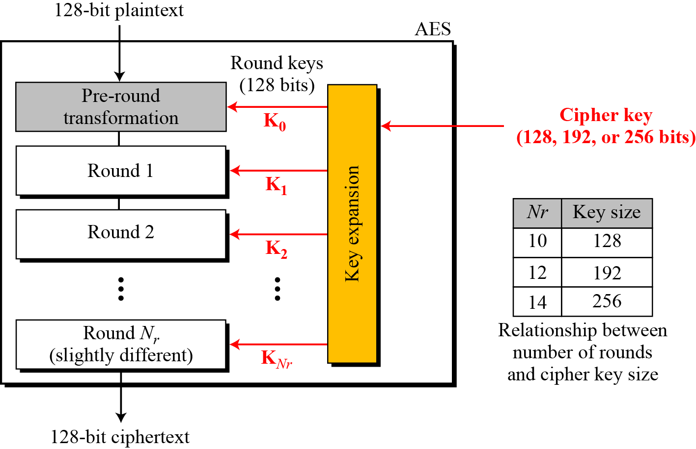
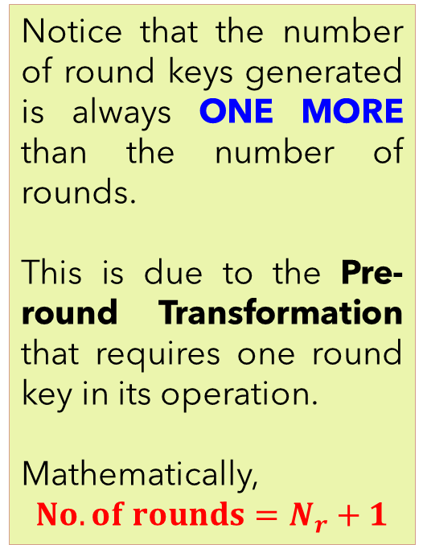
Notice that the number of round keys generated is always ONE MORE than the number of rounds.
This is due to the Pre-round Transformation that requires one round key in its operation.
Mathematically,
$$No. of rounds=N_{r}+1$$

Slide 10
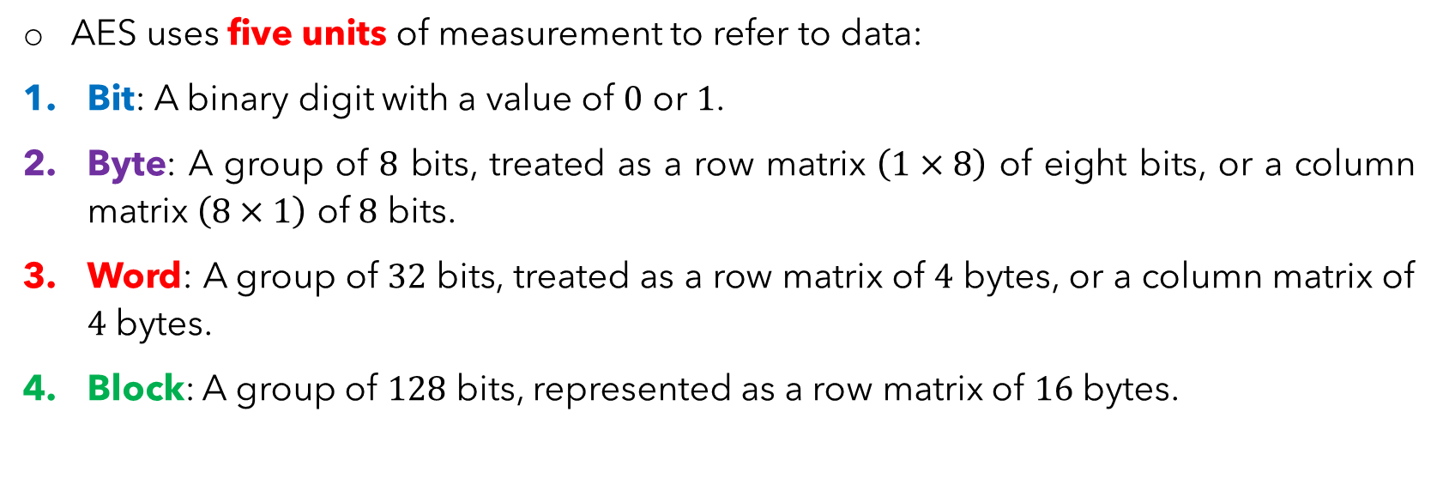
AES – Data Units
AES uses five units of measurement to refer to data:
Bit: A binary digit with a value of $0$ or $1$.
Byte: A group of $8$ bits, treated as a row matrix $\left(1×8\right)$ of eight bits, or a column matrix $\left(8×1\right)$ of $8$ bits.
Word: A group of $32$ bits, treated as a row matrix of $4$ bytes, or a column matrix of $4$ bytes.
Block: A group of $128$ bits, represented as a row matrix of $16$ bytes.

Slide 11
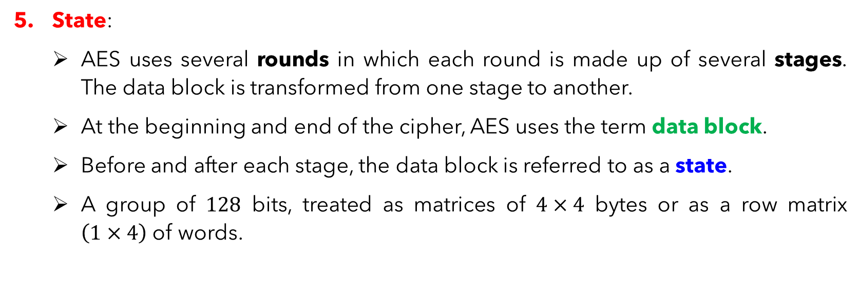
AES – Data Units
State:
AES uses several rounds in which each round is made up of several stages. The data block is transformed from one stage to another.
At the beginning and end of the cipher, AES uses the term data block.
Before and after each stage, the data block is referred to as a state.
A group of $128$ bits, treated as matrices of $4×4$ bytes or as a row matrix $\left(1×4\right)$ of words.

Slide 12
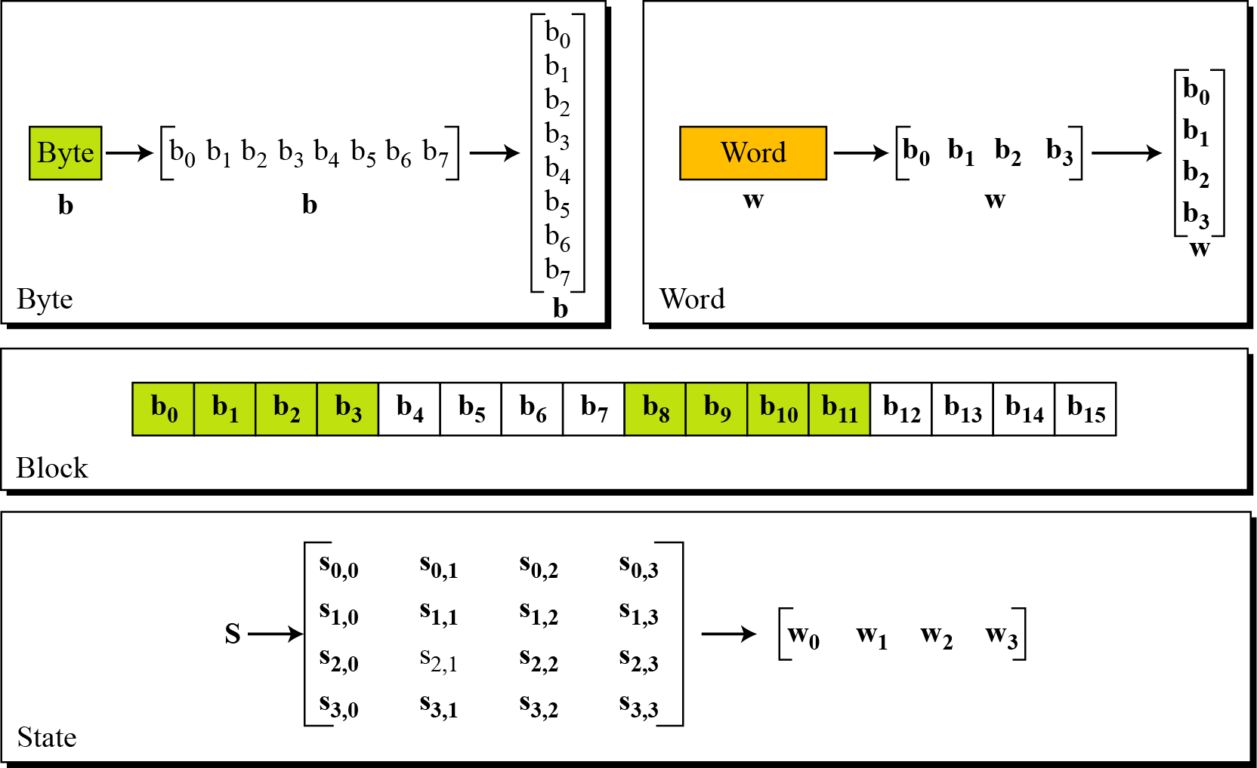

Slide 13
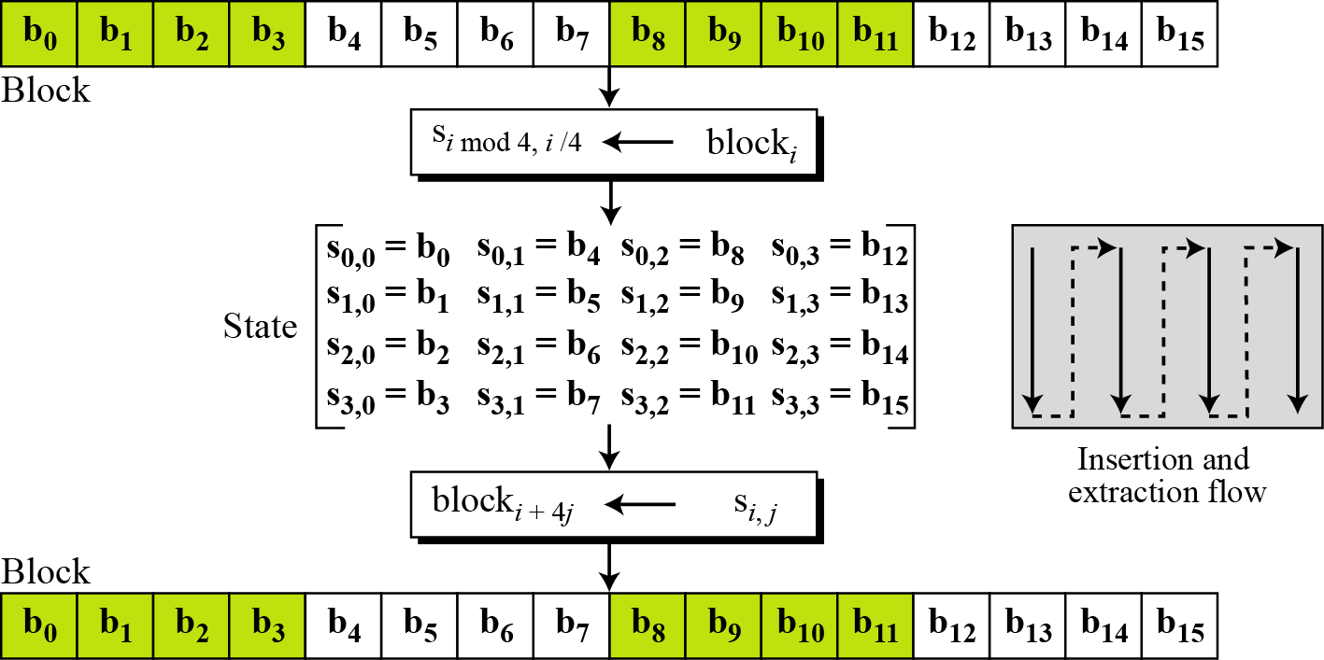
AES – Data Transformation

Slide 14
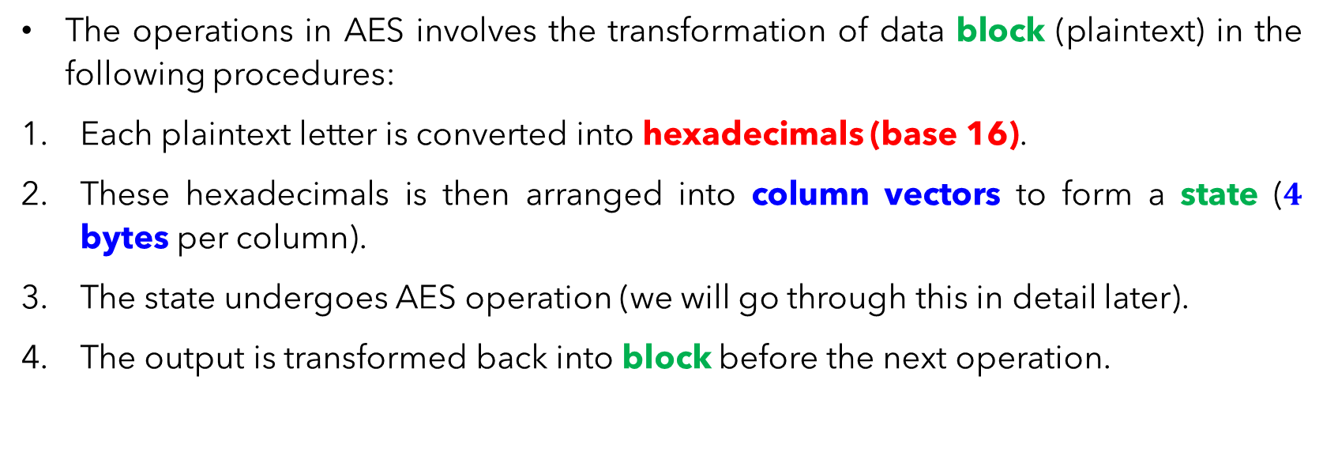
AES – Data Transformation
The operations in AES involves the transformation of data block (plaintext) in the following procedures:
Each plaintext letter is converted into hexadecimals (base 16).
These hexadecimals is then arranged into column vectors to form a state ($4$ bytes per column).
The state undergoes AES operation (we will go through this in detail later).
The output is transformed back into block before the next operation.

Slide 15
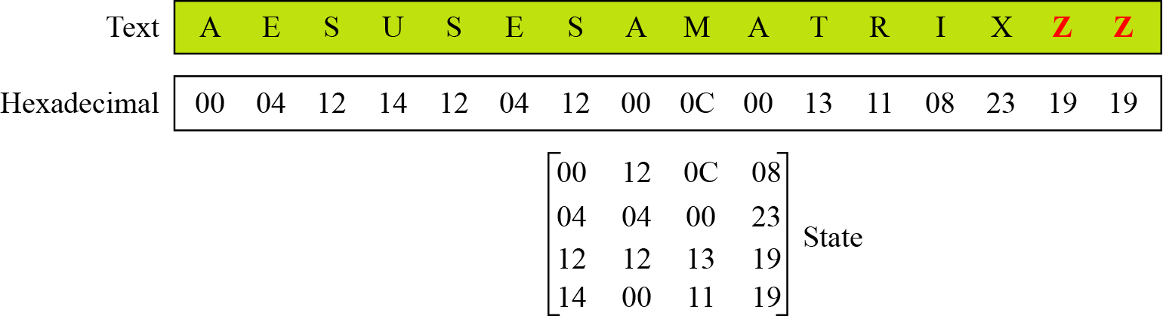

AES – Data Transformation
Example of block to state transformation of a plaintext. If the block is short of data (not a multiples of $16$), a padding using some arbitrary letters (such as X and Z) is done.

Slide 16
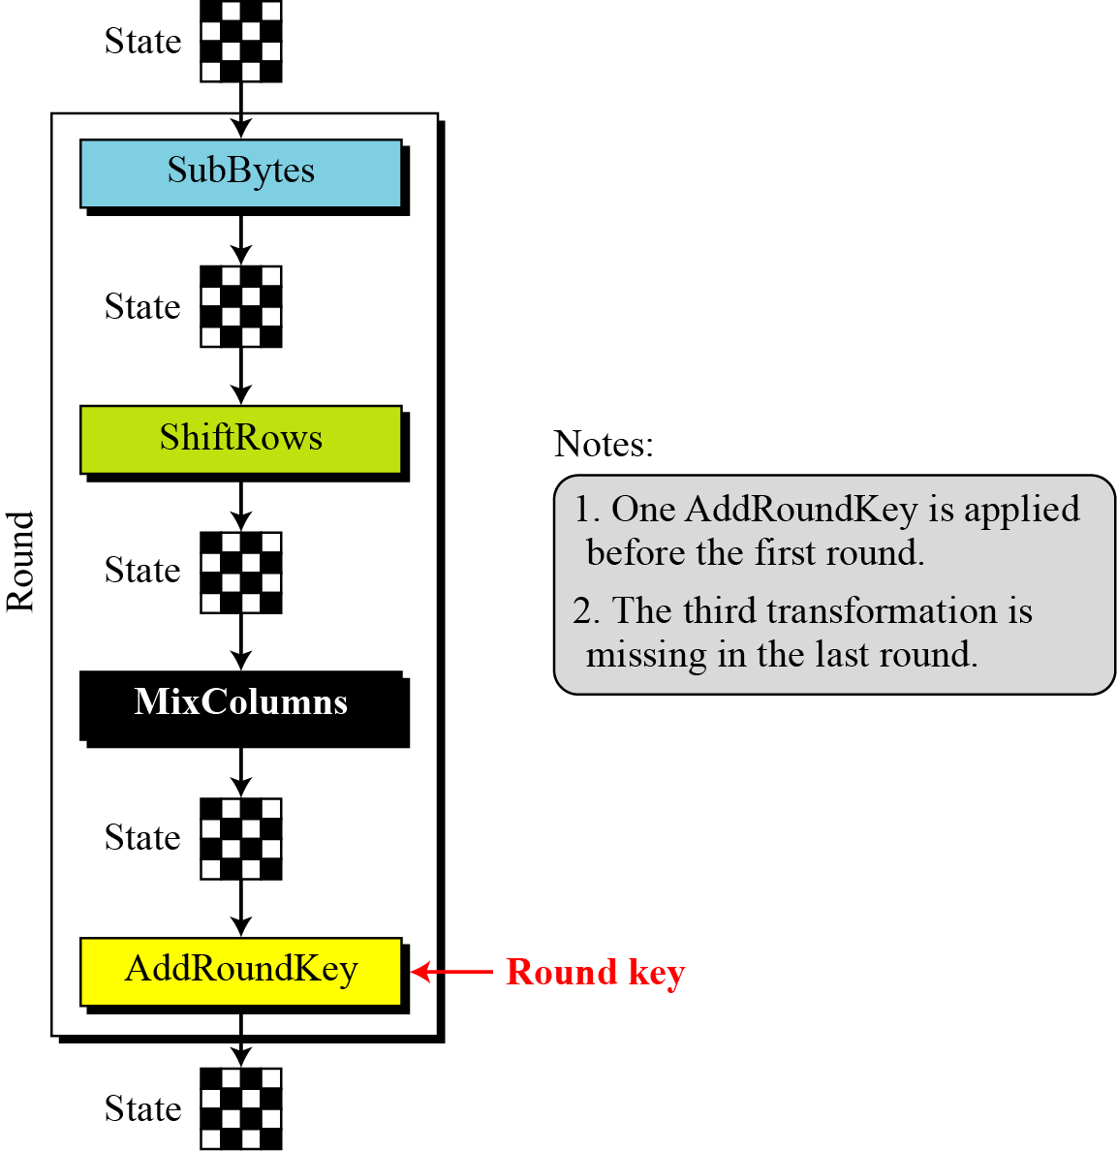
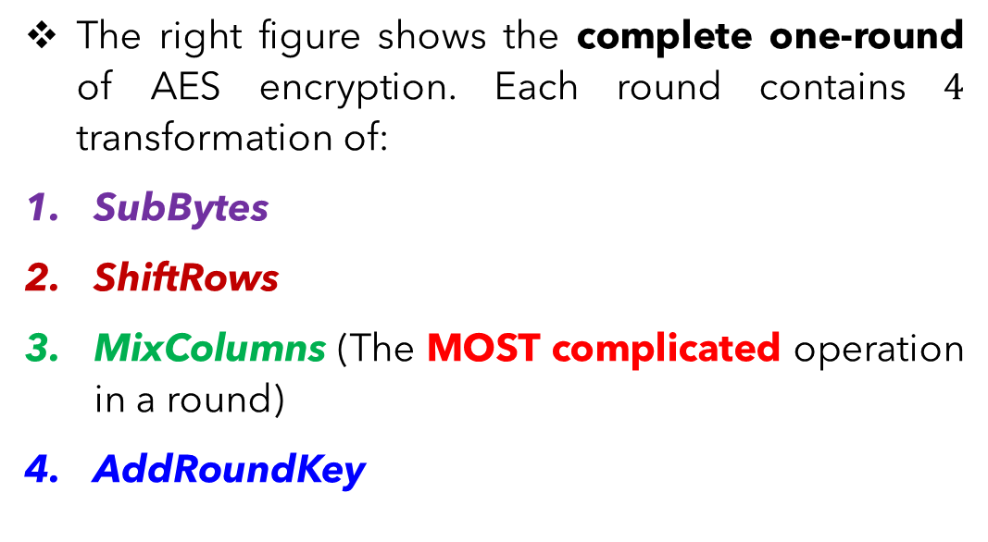
AES – Round Operations (Overview)
The right figure shows the complete one-round of AES encryption. Each round contains $4$ transformation of:
SubBytes
ShiftRows
MixColumns (The MOST complicated operation in a round)
AddRoundKey

Slide 17
AES – Round Operations (Overview)
Each transformation takes a state and creates another state to be used for the next transformation or the next round.
Encryption:
Pre-round performs only AddRoundKey transformation.
Last round do NOT undergo MixColumns transformation.
Decryption:
Uses inverse transformations of all the operations. Each transformation is either invertible via some fixed rules or self-invertible.

Slide 18
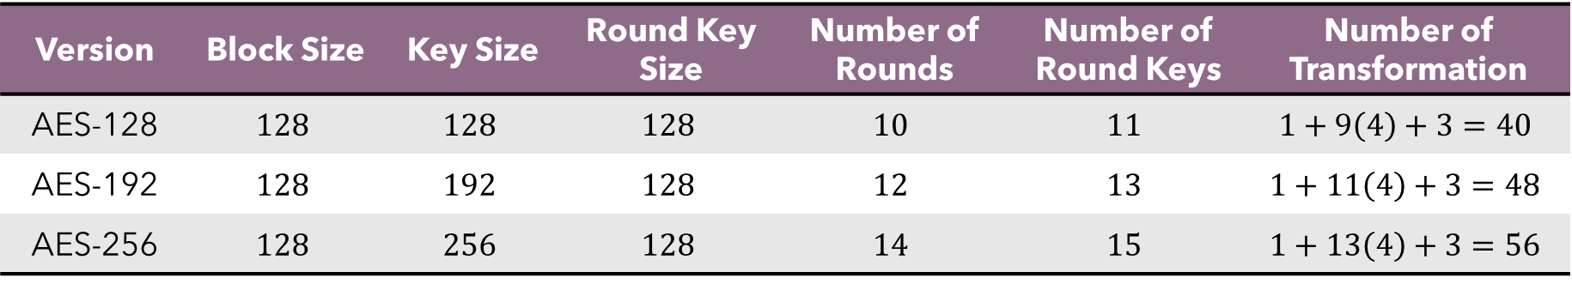
AES – Round Operations (Overview)
In summary, for a specific AES version, the total number of rounds and round keys required for each transformation are summarized in the following table.
Version | Block Size | Key Size | Round Key Size | Number of Rounds | Number of Round Keys | Number of Transformation
AES-128 | $$128$$ | $$128$$ | $$128$$ | $$10$$ | $$11$$ | $$1+9\left(4\right)+3=40$$
AES-192 | $$128$$ | $$192$$ | $$128$$ | $$12$$ | $$13$$ | $$1+11\left(4\right)+3=48$$
AES-256 | $$128$$ | $$256$$ | $$128$$ | $$14$$ | $$15$$ | $$1+13\left(4\right)+3=56$$

Slide 19
ADVANCED ENCRYPTION STANDARD (AES) SubBytes Substitution

Slide 20
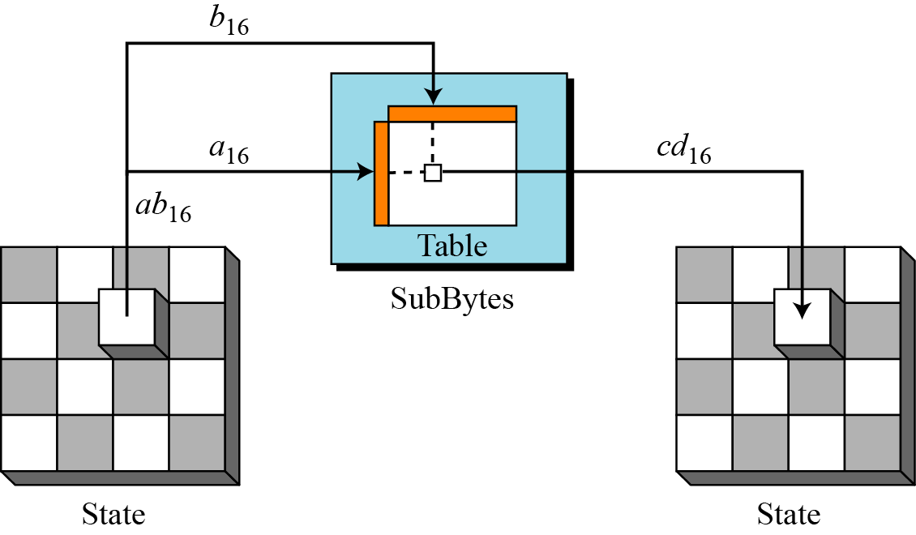
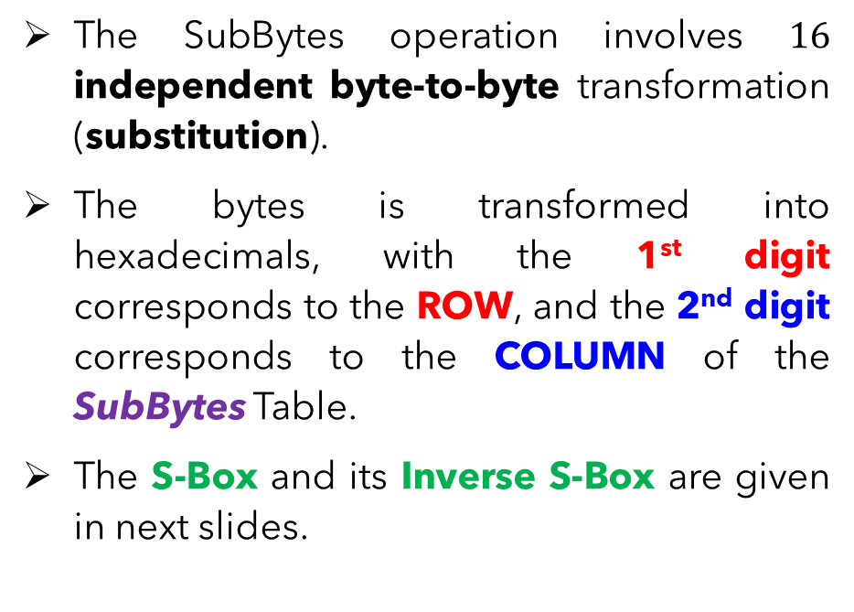
AES – SubBytes Substitution
The SubBytes operation involves $16$ independent byte-to-byte transformation (substitution).
The bytes is transformed into hexadecimals, with the 1st digit corresponds to the ROW, and the 2nd digit corresponds to the COLUMN of the SubBytes Table.
The S-Box and its Inverse S-Box are given in next slides.

Slide 21
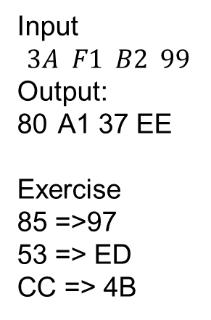
Input
$$3A F1 B2 99$$
Output:
A1 37 EE
Exercise
85 =>97
53 => ED
CC => 4B

Slide 22
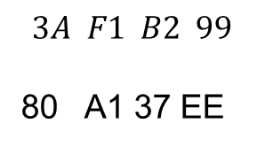
$$3A F1 B2 99$$
80 A1 37 EE

Slide 23
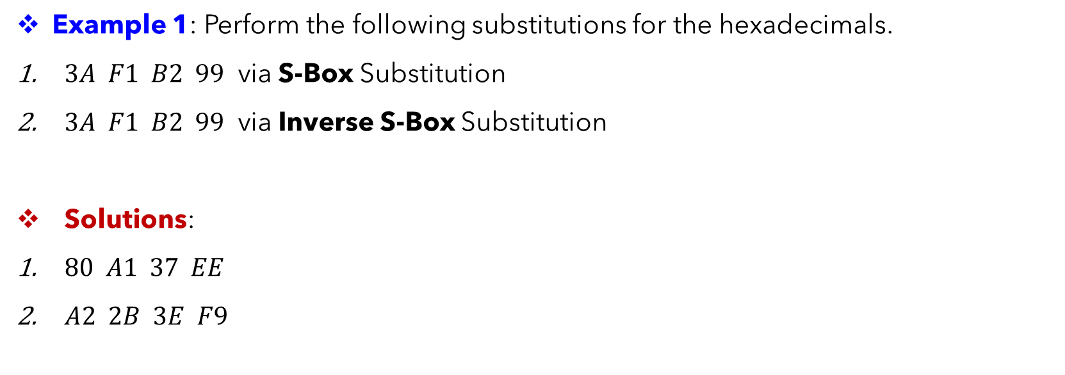
AES – SubBytes Substitution
Example 1: Perform the following substitutions for the hexadecimals.
$3A F1 B2 99$ via S-Box Substitution
$3A F1 B2 99$ via Inverse S-Box Substitution
Solutions:
$80 A1 37 EE$
$A2 2B 3E F9$

Slide 24
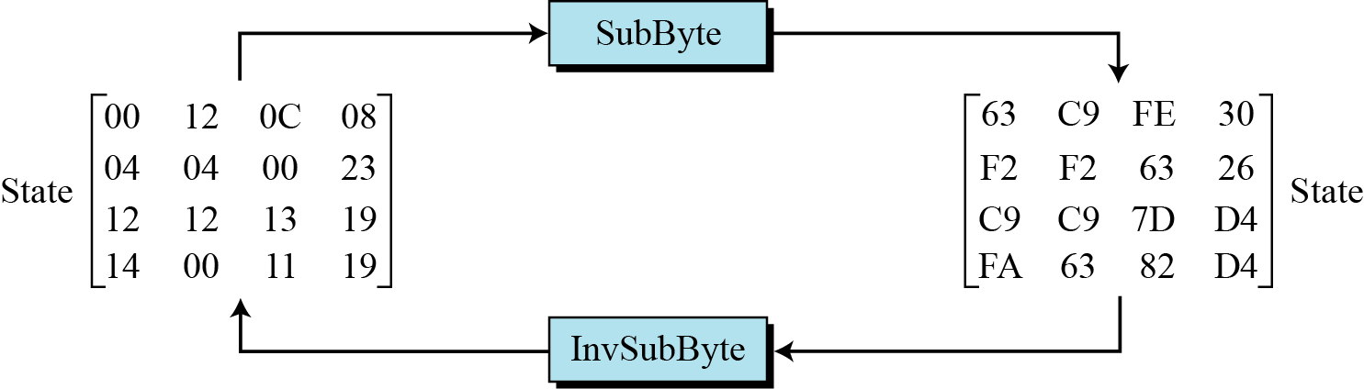
AES – SubBytes Substitution
Example 2: The figure shows a demonstration of SubBytes and Inverse SubBytes on a full state.

Slide 25
ADVANCED ENCRYPTION STANDARD (AES) ShiftRows

Slide 26
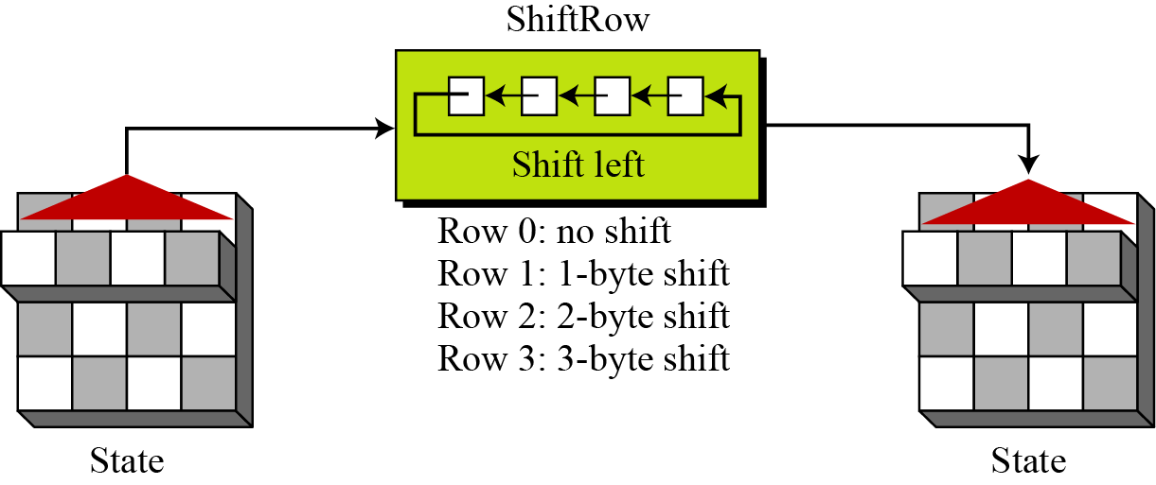
AES – ShiftRows
After the SubBytes transformation, the state undergoes the ShiftRows operations, in which each row is permuted (shifted different bytes to the LEFT) as shown below.

Slide 27
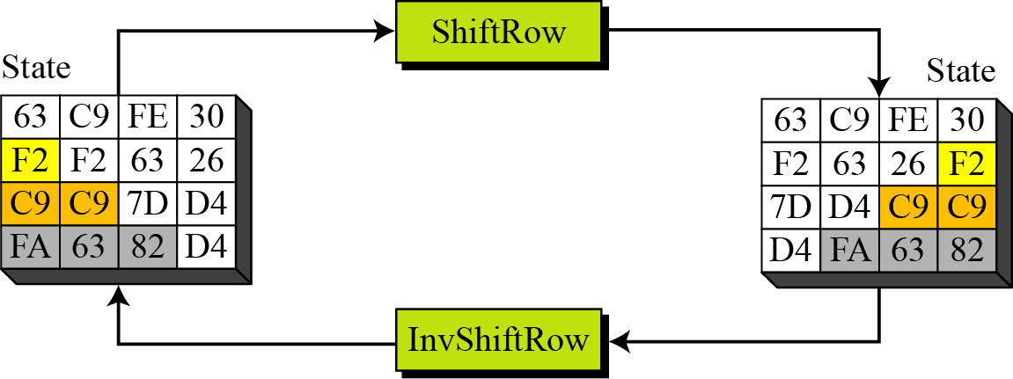
AES – ShiftRows
Example 3: We consider the following state and its operation via ShiftRows. Note that the Inverse ShiftRows is just RIGHT-shift the same bytes of ShiftRows.

Slide 28
ADVANCED ENCRYPTION STANDARD (AES) MixColumns

Slide 29
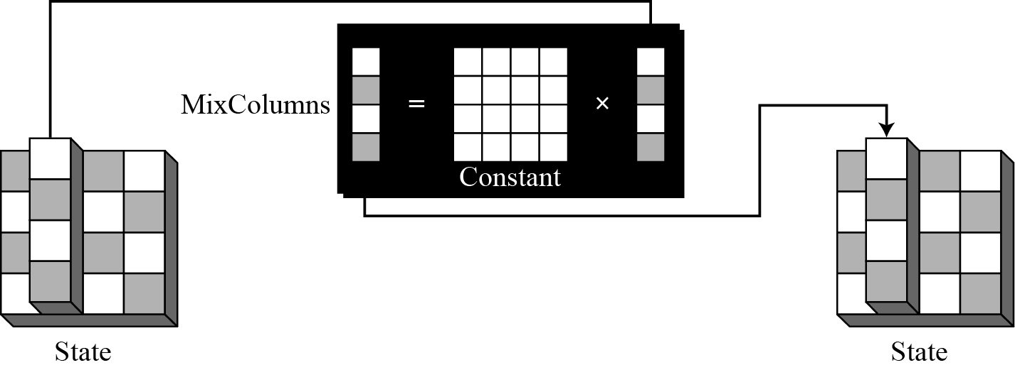
AES – MixColumns
MixColumns probably the most complicated part in AES, since there is no fixed table to refer to (like SubBytes).
It operates at the column level, by transforming each column of the state to a new column in another state.
The idea of MixColumns is to change the bits inside a byte, based on the bits inside the neighboring bytes (inter-byte transformation) using matrix multiplication with a key matrix.

Slide 30
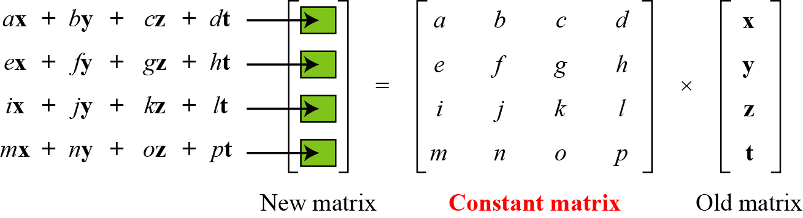
AES – MixColumns
The following illustrates the bytes-mixing using matrix multiplication.

Slide 31
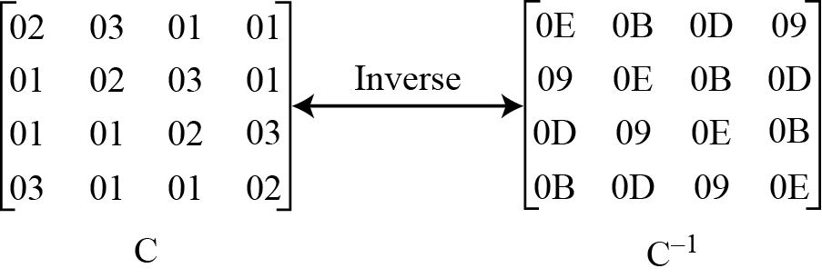
AES – MixColumns
In AES, the key matrix (constant matrix) and its inverse are fixed as follows.

Slide 32
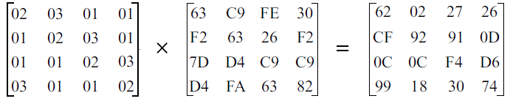
AES – MixColumns
The multiplication of MixColumns is NOT simply multiplying and adding each row to column as in normal matrices. Try the following example and observe it yourself.

Slide 33
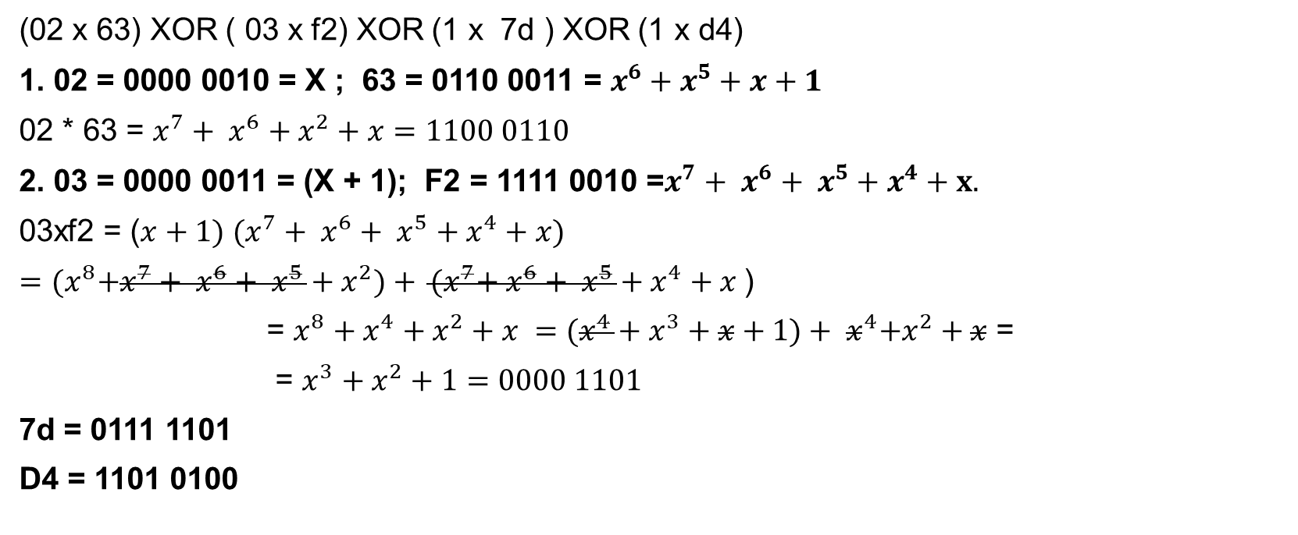
Example. How 62 is obtained. + = XOR
(02 x 63) XOR ( 03 x f2) XOR (1 x 7d ) XOR (1 x d4)
1. 02 = 0000 0010 = X ; 63 = 0110 0011 = $x^{6}+x^{5}+x+1$
02 * 63 = $x^{7}+ x^{6}+x^{2}+x=1100 0110$
2. 03 = 0000 0011 = (X + 1); F2 = 1111 0010 =$x^{7}+ x^{6}+ x^{5}+x^{4}+x.$
03xf2 = (${x+1) (x}^{7}+ x^{6}+ x^{5}+x^{4}+x)$
$={(x}^{8}+x^{7}+ x^{6}+ x^{5}+x^{2})+ {(x}^{7}+ x^{6}+ x^{5}+x^{4}+x$)
= $x^{8}+x^{4}+x^{2}+x ={(x^{4}+x^{3}+x+1)+ x}^{4}+x^{2}+x$ =
= $x^{3}+x^{2}+1=0000 1101$
7d = 0111 1101
D4 = 1101 0100
02x63 | 1 | 1 | 0 | 0 | 0 | 1 | 1 | 0
03xf2 | 0 | 0 | 0 | 0 | 1 | 1 | 0 | 1
7d | 0 | 1 | 1 | 1 | 1 | 1 | 0 | 1
d4 | 1 | 1 | 0 | 1 | 0 | 1 | 0 | 0
62 (xor) | 0 | 1 | 1 | 0 | 0 | 0 | 1 | 0

Slide 34
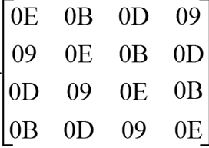
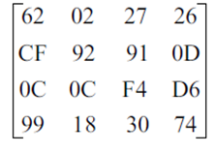
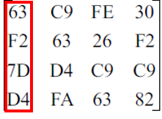
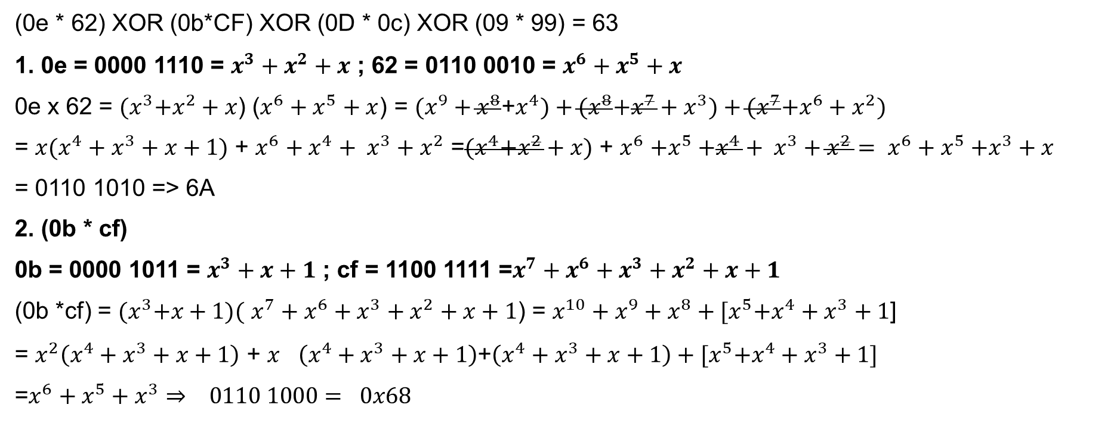
Inverse mix column
X
=
(0e * 62) XOR (0b*CF) XOR (0D * 0c) XOR (09 * 99) = 63
1. 0e = 0000 1110 = $x^{3}+x^{2}+x$ ; 62 = 0110 0010 = $x^{6}+x^{5}+x$
0e x 62 = ${(x}^{3}+x^{2}+x$) ($x^{6}+x^{5}+x$) = $(x^{9}+x^{8}$+$x^{4})+{(x}^{8}+x^{7}+x^{3})+{(x}^{7}+x^{6}+x^{2})$
= ${x(x^{4}+x}^{3}+x+1)$ + $x^{6}+x^{4}+ x^{3}+x^{2}$ =${(x}^{4}+x^{2}+x)$ + $x^{6}{+x}^{5}+x^{4}+ x^{3}+x^{2}= x^{6}{+ x}^{5}+x^{3}+x$
= 0110 1010 => 6A
2. (0b * cf)
0b = 0000 1011 = $x^{3}+x+1$ ; cf = 1100 1111 =$x^{7}+x^{6}+x^{3}+x^{2}+x+1$
(0b *cf) = ${(x}^{3}+x+1)($ $x^{7}+x^{6}+x^{3}+x^{2}+x+1$) = $x^{10}+x^{9}+x^{8}+{[x}^{5}+x^{4}+x^{3}+1$]
= $x^{2}\left(x^{4}+x^{3}+x+1\right)$ + $x^{}\left(x^{4}+x^{3}+x+1\right)$+$\left(x^{4}+x^{3}+x+1\right)+{[x}^{5}+x^{4}+x^{3}+1]$
=$x^{6}+x^{5}+x^{3}⇒ 0110 1000= 0x68$

Slide 35
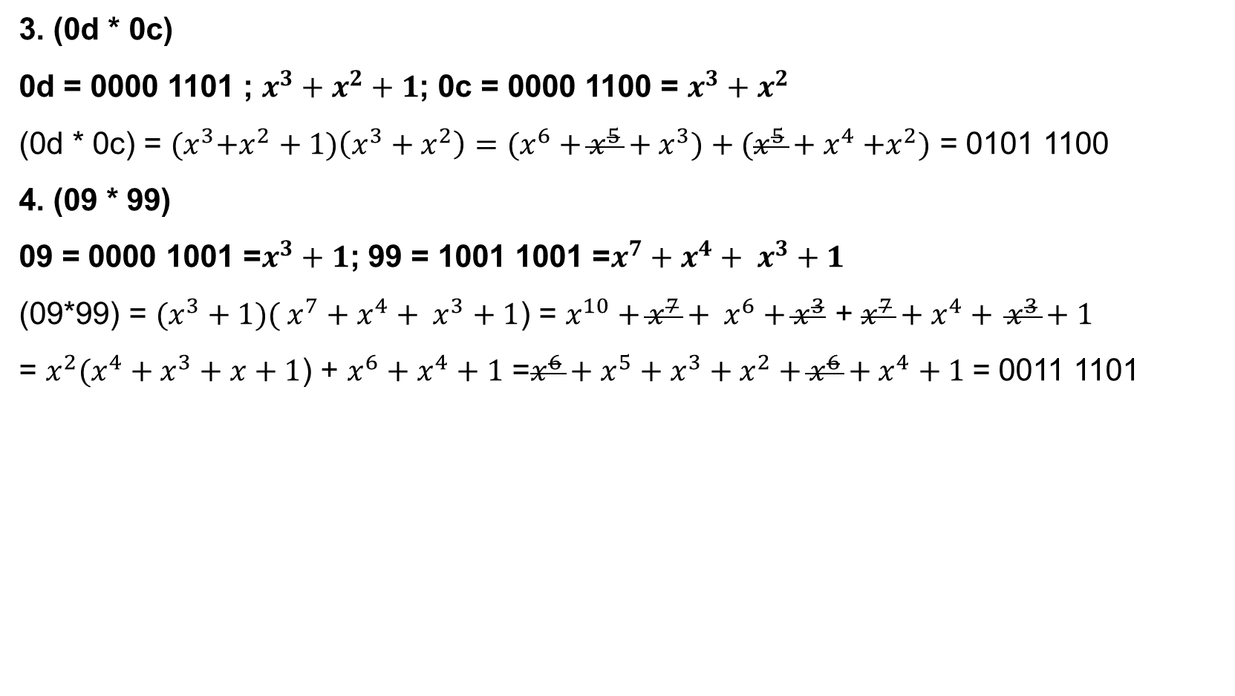
Inverse mix column
1011 0101
3. (0d * 0c)
0d = 0000 1101 ; $x^{3}+x^{2}+1$; 0c = 0000 1100 = $x^{3}+x^{2}$
(0d * 0c) = ${(x}^{3}+x^{2}+1)\left(x^{3}+x^{2}\right)=(x^{6}+x^{5}+x^{3})+(x^{5}{+ x}^{4}+x^{2})$ = 0101 1100
4. (09 * 99)
09 = 0000 1001 =$x^{3}+1$; 99 = 1001 1001 =$x^{7}+x^{4}+ x^{3}+1$
(09*99) = $(x^{3}+1)( x^{7}+x^{4}+ x^{3}+1$) = $x^{10}+x^{7}+ x^{6}+x^{3}$ + $x^{7}+x^{4}+ x^{3}+1$
= $x^{2}(x^{4}+x^{3}+x+1$) + $x^{6}+x^{4}+1$ =$x^{6}+x^{5}+x^{3}+x^{2}+x^{6}+x^{4}+1$ = 0011 1101
1111 1011
0e*62 | 0 | 1 | 1 | 0 | 1 | 0 | 1 | 0
0b*cf | 0 | 1 | 1 | 0 | 1 | 0 | 0 | 0
0d*0c | 0 | 1 | 0 | 1 | 1 | 1 | 0 | 0
09*99 | 0 | 0 | 1 | 1 | 1 | 1 | 0 | 1
0x63 (x0r) | 0 | 1 | 1 | 0 | 0 | 0 | 1 | 1

Slide 36
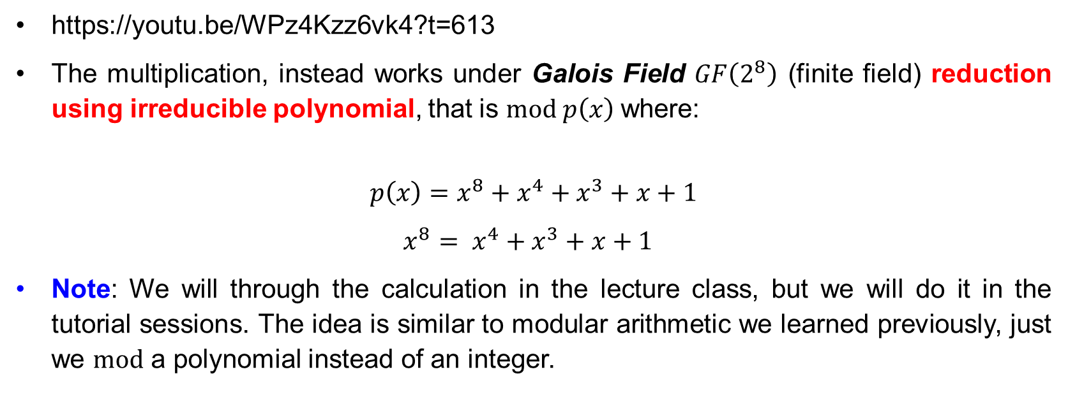
AES – MixColumns
https://youtu.be/WPz4Kzz6vk4?t=613
The multiplication, instead works under Galois Field $GF\left(2^{8}\right)$ (finite field) reduction using irreducible polynomial, that is $mod p\left(x\right)$where:
$$p\left(x\right)=x^{8}+x^{4}+x^{3}+x+1$$
$x^{8}= x^{4}+x^{3}+x+1$
Note: We will through the calculation in the lecture class, but we will do it in the tutorial sessions. The idea is similar to modular arithmetic we learned previously, just we $mod$ a polynomial instead of an integer.

Slide 37
ADVANCED ENCRYPTION STANDARD (AES) AddRoundKey

Slide 38
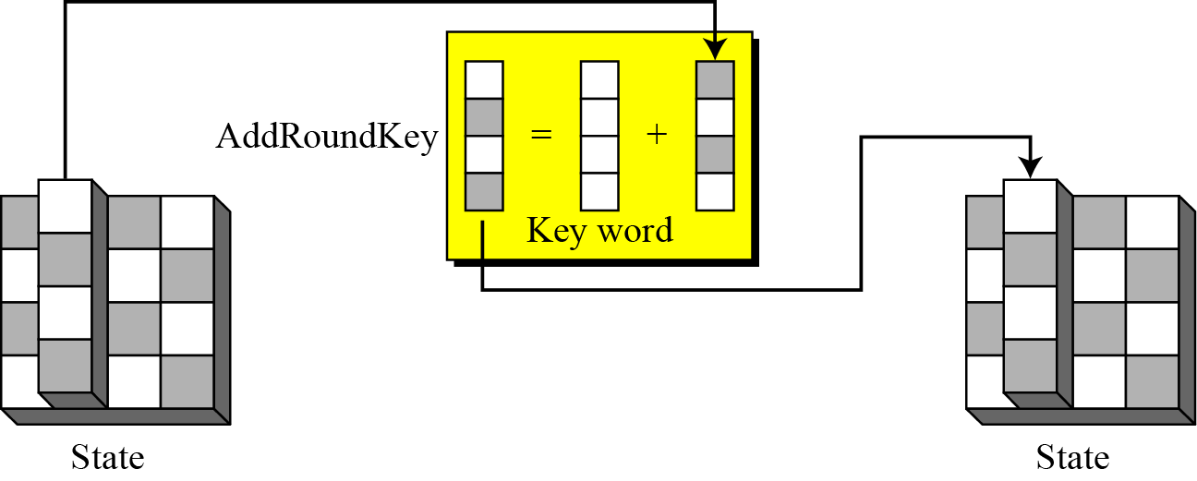
AES – AddRoundKey
The AddRoundKey operates at the column level using matrix addition using exclusive-OR (XOR) operation.

Slide 39
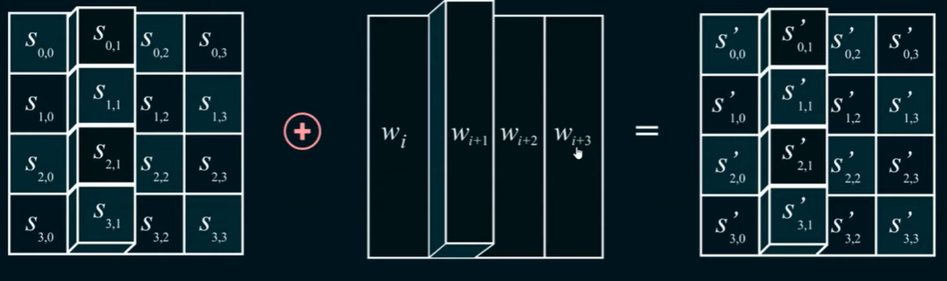
AddRound Key. “i“ is the round No.
Round Key 0 = w0,w1,w2,w3​
Round Key 1 = w4,w5,w6,w7​
…
Round Key 4 = w16,w17,w18,w19
Encryption (StateNew = StateOld XOR RoundKey)
Decryption (StateOld = StateNew XOR RoundKey)​

Slide 40
AES Decryption
AES Encryption
SubBytes Substitution => ShiftRows => MixColumns => Add Round Key
AES Decryption (not the same order)
Inverse ShiftRows => Inverse SubBytes => Add RoundKey => MixColumn
This is done for performance & Ease of implementation purposes

Slide 41
ADVANCED ENCRYPTION STANDARD (AES) Key Expansion

Slide 42
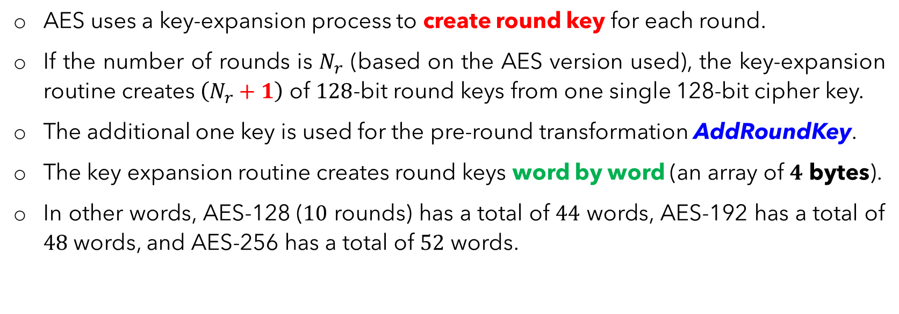
AES – Key Expansion (Overview)
AES uses a key-expansion process to create round key for each round.
If the number of rounds is $N_{r}$ (based on the AES version used), the key-expansion routine creates $\left(N_{r}+1\right)$ of $128$-bit round keys from one single 128-bit cipher key.
The additional one key is used for the pre-round transformation AddRoundKey.
The key expansion routine creates round keys word by word (an array of $4$ bytes).
In other words, AES-128 ($10$ rounds) has a total of $44$ words, AES-192 has a total of $48$ words, and AES-256 has a total of $52$ words.

Slide 43
AES – Key Expansion (Overview)
The following table shows the general words created for each round.
As a demonstration, in next few slides, we consider the key expansion in AES-128 by observing how the round key is created from words.

Slide 44
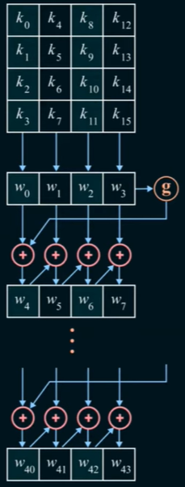
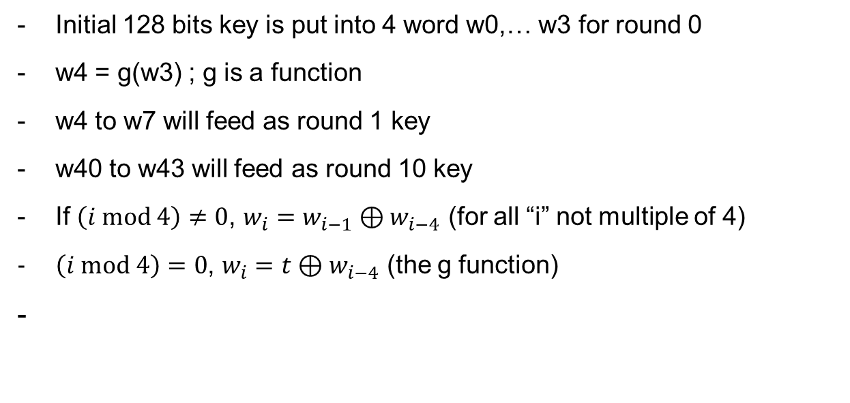
Key Expansion Overview
Initial 128 bits key is put into 4 word w0,… w3 for round 0
w4 = g(w3) ; g is a function
w4 to w7 will feed as round 1 key
w40 to w43 will feed as round 10 key
If $\left(i mod 4\right)≠0$, $w_{i}=w_{i−1}⊕w_{i−4}$ (for all “i” not multiple of 4)
$\left(i mod 4\right)=0$, $w_{i}=t⊕w_{i−4}$ (the g function)
-

Slide 45
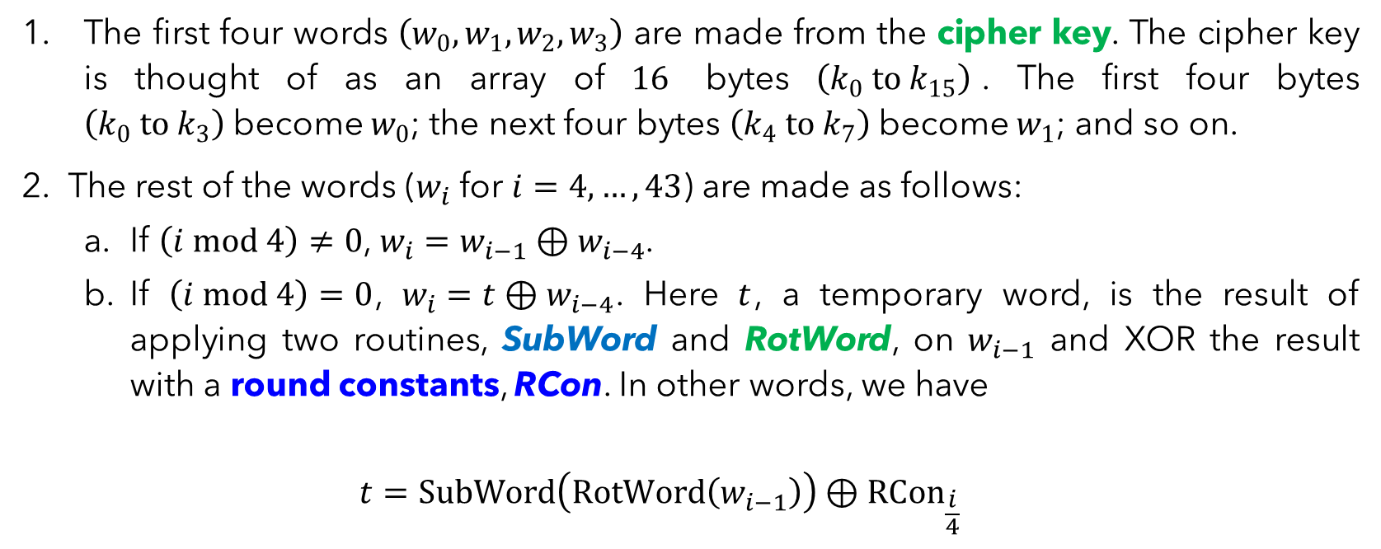
AES – Key Expansion (AES-128)
The first four words $\left(w_{0},w_{1},w_{2},w_{3}\right)$ are made from the cipher key. The cipher key is thought of as an array of $16$ bytes $\left(k_{0} to k_{15}\right)$. The first four bytes $\left(k_{0} to k_{3}\right)$become $w_{0}$; the next four bytes $\left(k_{4} to k_{7}\right)$become $w_{1}$; and so on.
The rest of the words ($w_{i}$ for $i=4,…,43$) are made as follows:
If $\left(i mod 4\right)≠0$, $w_{i}=w_{i−1}⊕w_{i−4}$.
If $\left(i mod 4\right)=0$, $w_{i}=t⊕w_{i−4}$. Here $t$, a temporary word, is the result of applying two routines, SubWord and RotWord, on $w_{i−1}$ and XOR the result with a round constants, RCon. In other words, we have
$$t=SubWord\left(RotWord\left(w_{i−1}\right)\right)⊕{RCon}_{\frac{i}{4}}$$

Slide 46
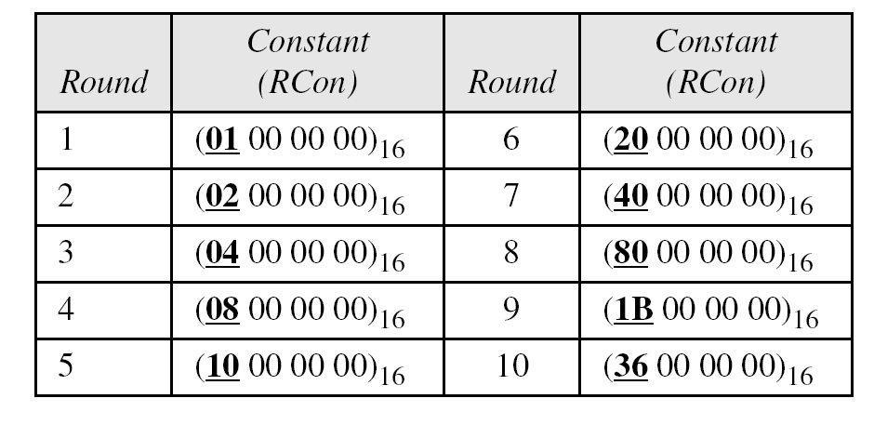
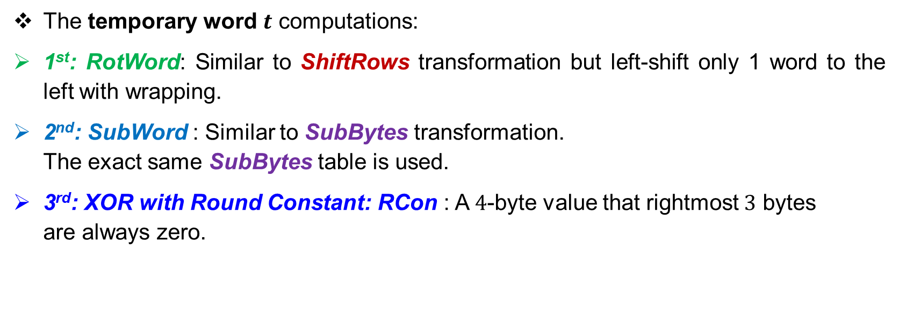
AES – Key Expansion (AES-128)
The temporary word $t$ computations:
1st: RotWord: Similar to ShiftRows transformation but left-shift only 1 word to the left with wrapping.
2nd: SubWord : Similar to SubBytes transformation. The exact same SubBytes table is used.
3rd: XOR with Round Constant: RCon : A $4$-byte value that rightmost $3$ bytes are always zero.

Slide 47
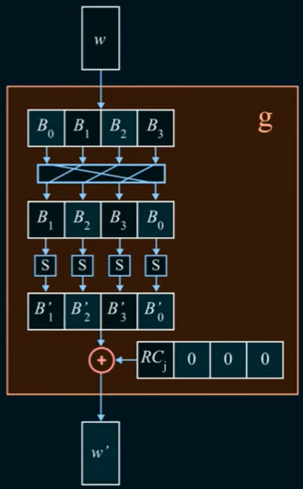
G-Function
Inside the function
1st Rotate left 1 byte
2nd: SubBytes Transformation using the same SubBytes table
3rd: XOR with Rcon (refer to table below)
Note: g-function is a name only
Right 3 bytes all
zeros

Slide 48
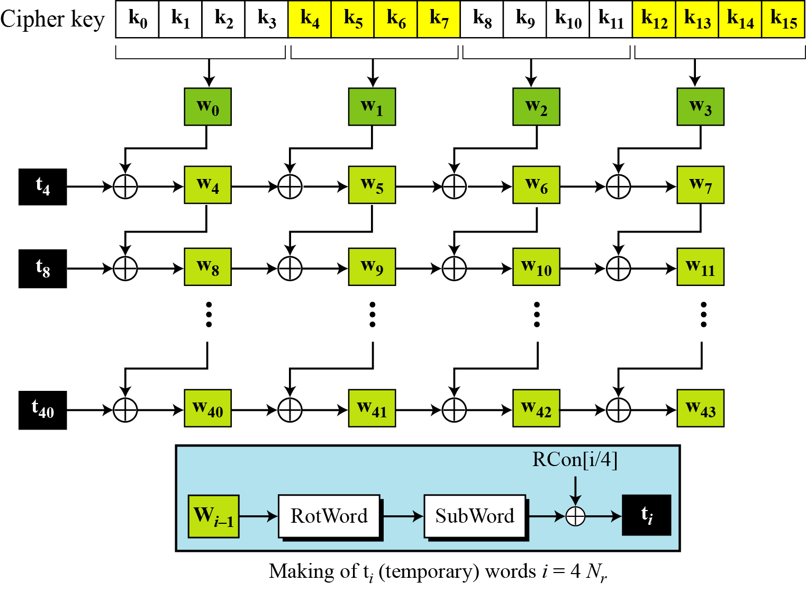

Slide 50
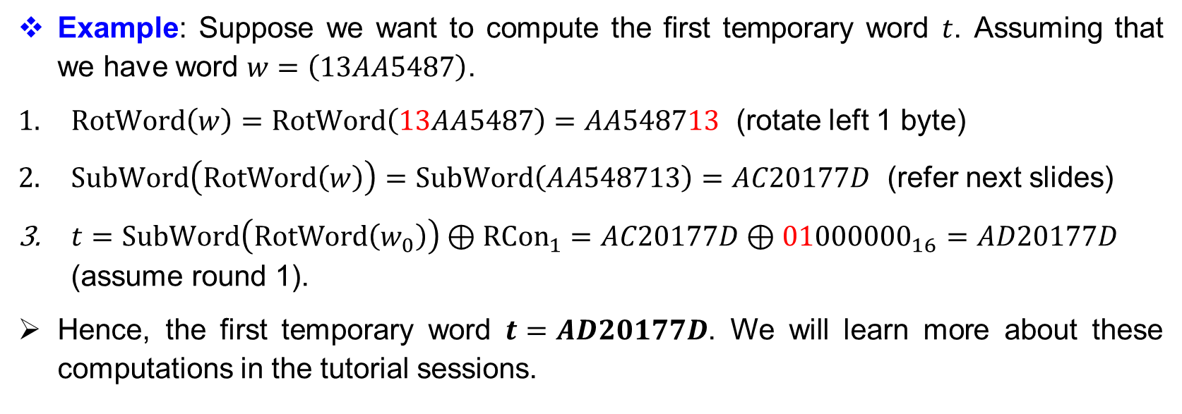
AES – Key Expansion (AES-128)
Example: Suppose we want to compute the first temporary word $t$. Assuming that we have word $w=\left(13AA5487\right)$.
$RotWord\left(w\right)=RotWord\left(13AA5487\right)=AA548713$ (rotate left 1 byte)
$SubWord\left(RotWord\left(w\right)\right)=SubWord\left(AA548713\right)=AC20177D$ (refer next slides)
$t=SubWord\left(RotWord\left(w_{0}\right)\right)⊕{RCon}_{1}=AC20177D⊕{01000000}_{16}=AD20177D$ (assume round 1).
Hence, the first temporary word $t=AD20177D$. We will learn more about these computations in the tutorial sessions.

Slide 51
$$SubWord\left(AA548713\right)=AC20177D$$
4
2
3
1

Slide 52
ADVANCED ENCRYPTION STANDARD (AES) Complete AES Ciphers

Slide 53
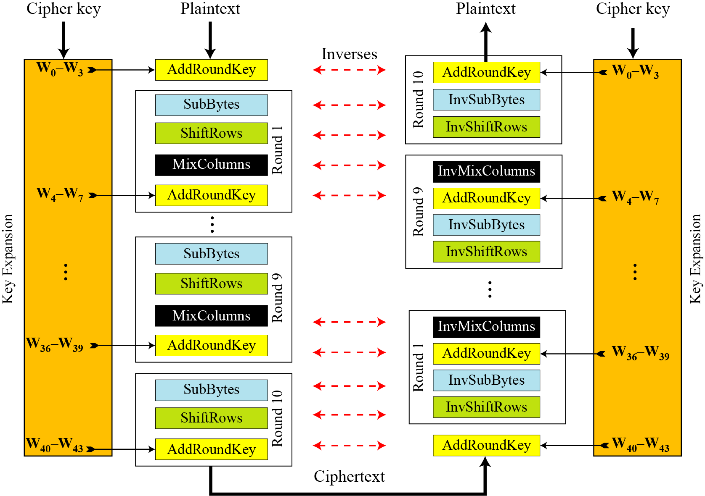

Slide 54
ADVANCED ENCRYPTION STANDARD (AES) AES vs DES Comparative Analysis

Slide 55
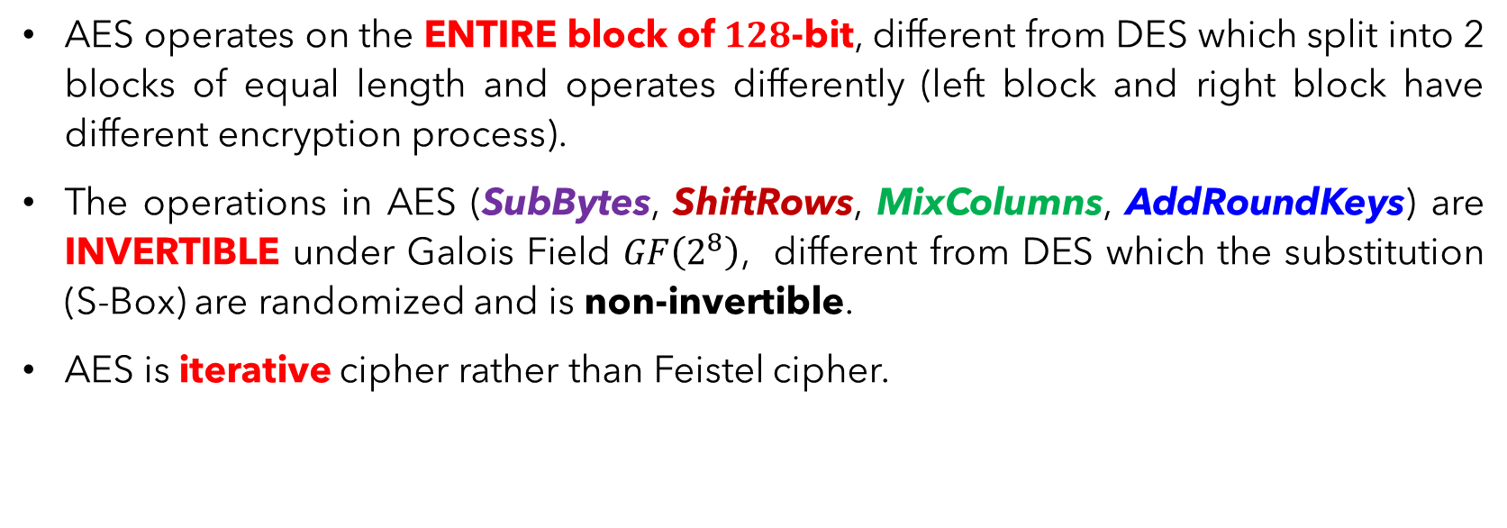
AES – Non-Feistel Ciphers
AES operates on the ENTIRE block of $128$-bit, different from DES which split into 2 blocks of equal length and operates differently (left block and right block have different encryption process).
The operations in AES (SubBytes, ShiftRows, MixColumns, AddRoundKeys) are INVERTIBLE under Galois Field $GF\left(2^{8}\right)$, different from DES which the substitution (S-Box) are randomized and is non-invertible.
AES is iterative cipher rather than Feistel cipher.

Slide 56
Bit & Bytes Orientations (Substitution)
Operation | AES | DES
 | Byte-Oriented | Bit-Oriented
Substitution | SubBytes Transformation takes a byte and change it to another byte. Need only one substitution table. | S-Box takes 6-bit and transforms it to 4-bit. Need 8 S-boxes to create a 32-bit half block.

Slide 57
Bit & Bytes Orientations (Permutation)
Operation | AES | DES
 | Byte-Oriented | Bit-Oriented
Permutation | ShiftRows transformation transposes bytes. Permutation is applied straight on the bytes. There is no expansion permutation needed. | P-Box transposes bits. Permutation is applied before and after substitution. Expansion permutation is needed to create a 48-bit half block from a 32-bit half block. This is needed since the round key is 48-bit long.

Slide 58
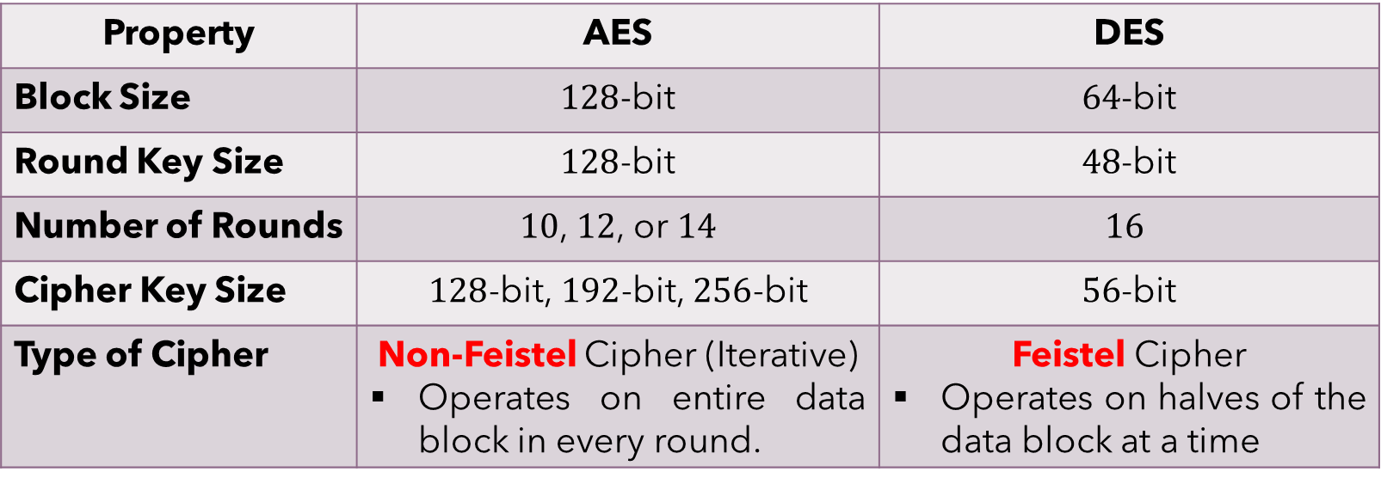
AES versus DES – Properties
Property | AES | DES
Block Size | $128$-bit | $64$-bit
Round Key Size | $128$-bit | $48$-bit
Number of Rounds | $10$, $12$, or $14$ | $$16$$
Cipher Key Size | $128$-bit, $192$-bit, $256$-bit | $56$-bit
Type of Cipher | Non-Feistel Cipher (Iterative) Operates on entire data block in every round. | Feistel Cipher Operates on halves of the data block at a time

Slide 59
ADVANCED ENCRYPTION STANDARD (AES) AES Security

Slide 60
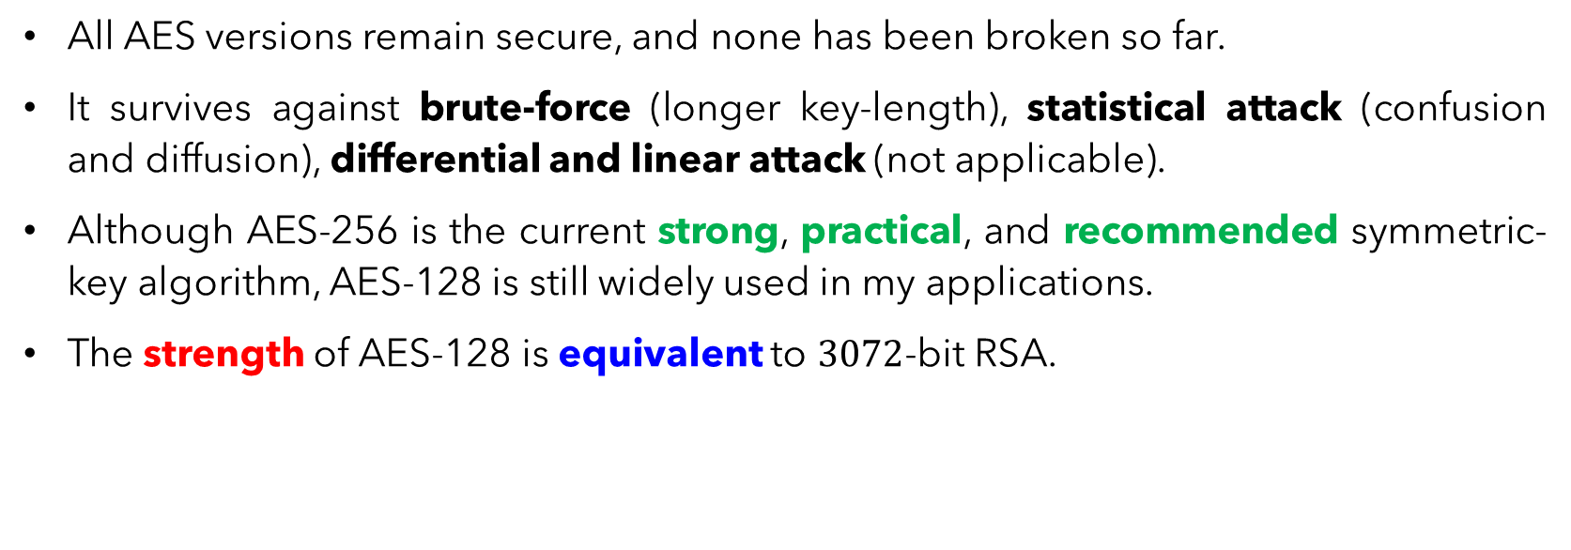
AES – Security
All AES versions remain secure, and none has been broken so far.
It survives against brute-force (longer key-length), statistical attack (confusion and diffusion), differential and linear attack (not applicable).
Although AES-256 is the current strong, practical, and recommended symmetric-key algorithm, AES-128 is still widely used in my applications.
The strength of AES-128 is equivalent to $3072$-bit RSA.

Slide 61
Main References for Chapter 5
Stallings, W. “Cryptography and Network Security: Principles and Practices”, Fifth Edition, Pearson Prentice Hall, 2011.
Forouzan, B.A. “Introduction to Cryptography and Network Security”, Third Edition, McGraw-Hill, 2008.

Slide 62
~ THE END ☺ ~

